Slide 1
Chapter 4.
Timer, Serial Port and interrupt in Assembly and C

Slide 2
Contents
4.1. Programming Timer 0, 1, 2. 3
  Programming Timer 0 and 1 in C
4.2. Counter programming
4.3. Serial communication
4.4.Interrupts

Slide 3
PIC 18 TIMER PROGRAMMMING
Upon completion of this section, you will able to:
  List the timers of the PIC18 and their associated registers
  Describe the various modes of the PIC timers
  Program the PIC18 timers in Assembly and C to generate time delays
  Program the PIC18 counters in Assembly and C as event counters

Slide 4
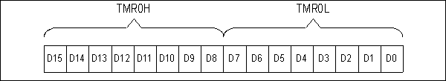
Timer 0 High and Low Registers
4.1. Programming Timer 0 and 1
Basic registers of the timer

Slide 5
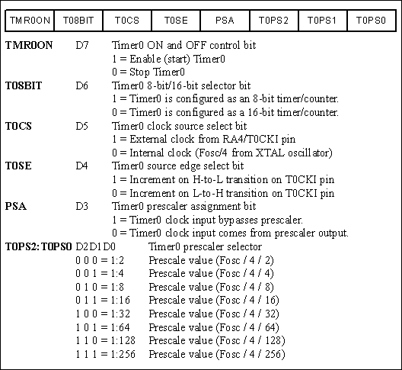
T0CON (Timer0 Control) Register

Slide 6
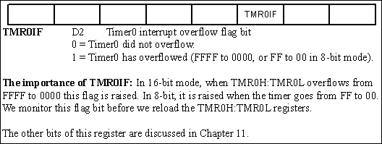
INTCON (Interrupt Control Register) has the TMR0IF Flag

Slide 7
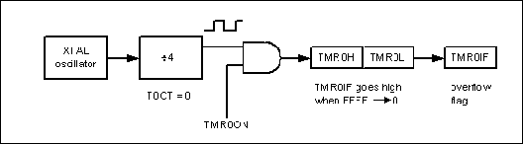
Timer0 Overflow Flag

Slide 8
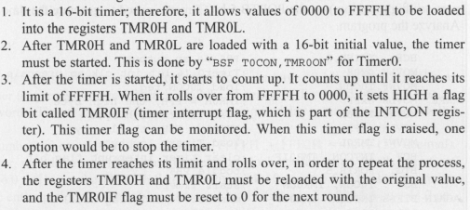
16-bit timer programming

Slide 9
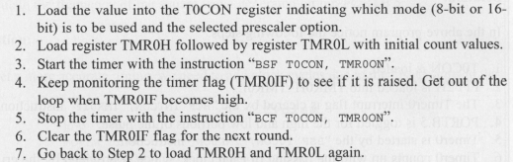

Slide 10
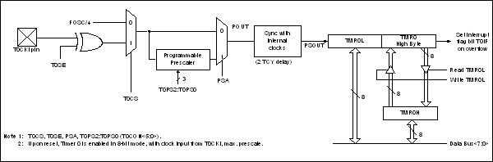
Timer0 16-bit Block Diagram

Slide 11
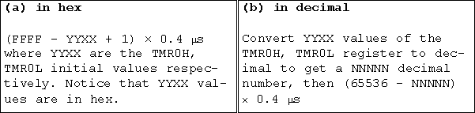
Timer Delay Calculation for XTAL = 10 MHz with No Prescaler

Slide 12
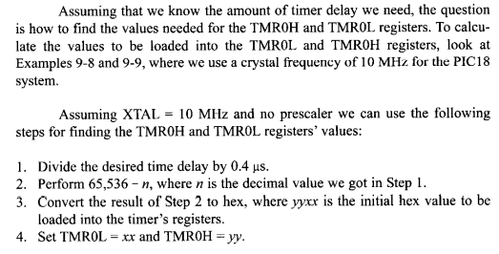
Finding value to bet loaded into the timer

Slide 13
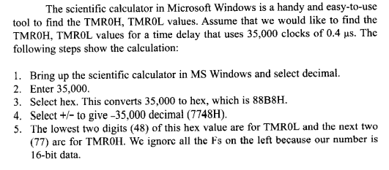
Using the windows calculator to find TH, TL

Slide 14
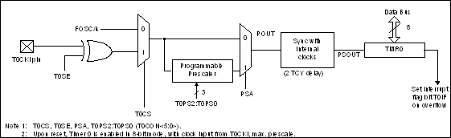
Timer0 8-bit Block Diagram
8-bit mode programming of Timer0

Slide 15
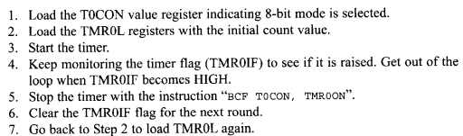
Step to program 8-bit of Timer 0

Slide 16
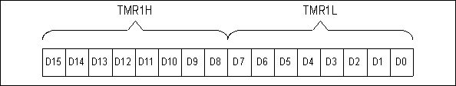
Timer1 Programming
Timer1 High and Low Registers

Slide 17
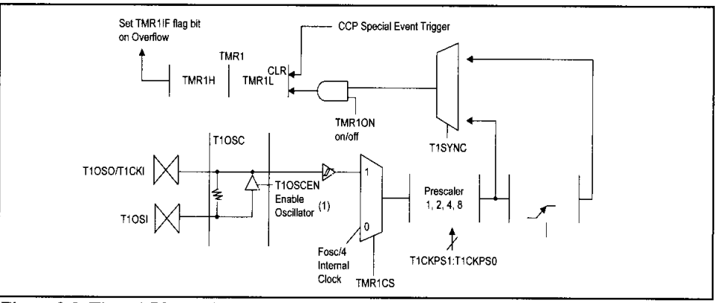
Timer1 Block Diagram

Slide 18
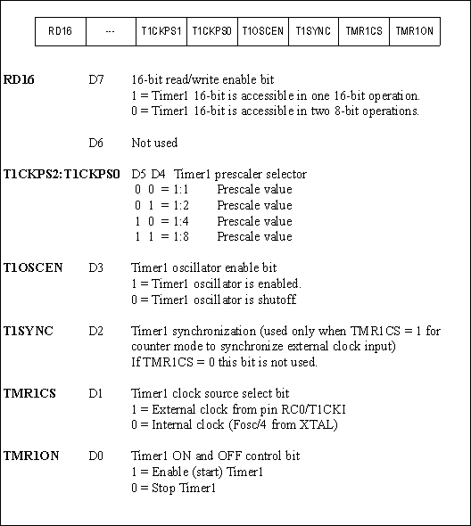
T1CON (Timer 1 Control ) Register

Slide 19
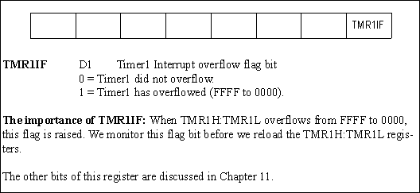
Interrupt Control Register 1 Contains the TMR1IF Flag

Slide 20
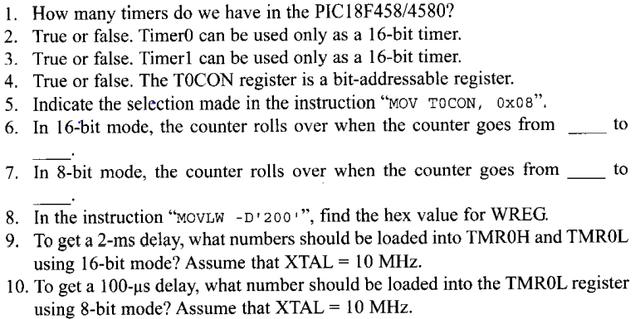
Review Question

Slide 21
Programming Timer 0 and 1 in C
Accessing timer in C
  Example 9-28: show how to access the TMR0ON and TMR0IF flag bits
Calculating delay length using timers
  The delay depends on two factor(a)Crystal freq, (b) the pre-scaler (c) various C compilers generate different hex code sizes
  Study example 9-28 through 9-33 and verify them using an oscilloscope.

Slide 22
C Programming of Timer 0 and 1 as counter
  Example 9-34 through 9-37 to see how Timer0 and 1 are programmed as counters using C language

Slide 23
PROGRAMMING TIMER2 AND 3

Slide 24
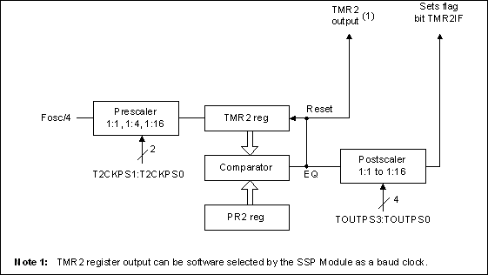
Timer2 Block Diagram
Timer2 programming

Slide 25
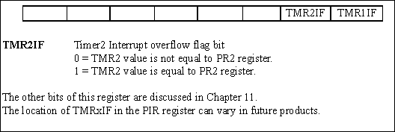
PIR1 (Peripheral Interrupt Flag Register 1) Contains TMR2IF Flag

Slide 26
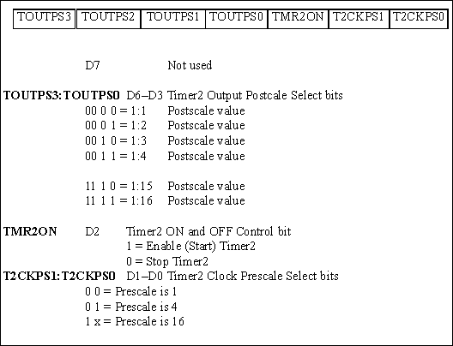
T2CON (Timer2 Control) Register

Slide 27
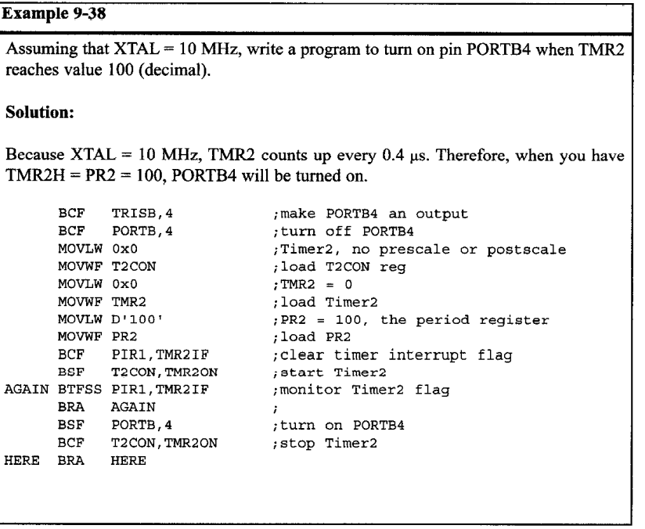

Slide 28
Timer3 Programming
Timer3 is a 16-bit timer can be used as timer or counter
  Is split into 2 bytes referred to as TMR3L and TMR3H

Slide 29
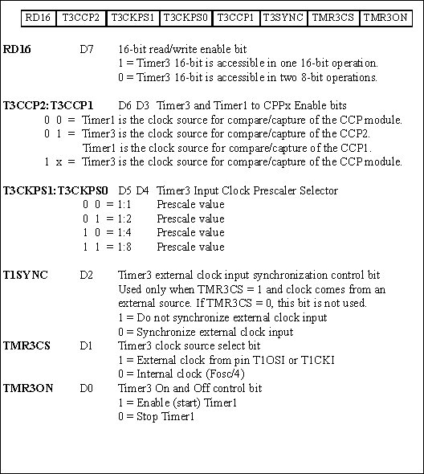
T3CON (Timer3 Control) Register

Slide 30
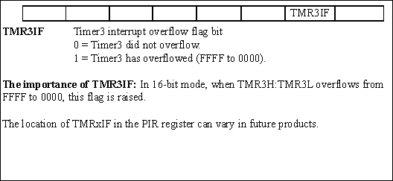
PIR2 (Peripheral Interrupt Flag Register 2) Contains the TMR3IF Flag

Slide 31
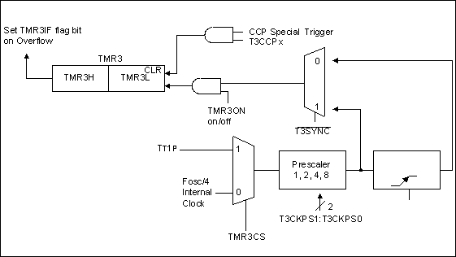
Timer3 Block Diagram

Slide 32
4.2.Counter Programing
When it used as a counter, pulse outside the PIC18 that increments the TH, TL registers.
In counter mode, notice that register such as T0CON, TMR0H and TMR0L are the same as for the timer discussed in the last section, they even have the same name.

Slide 33
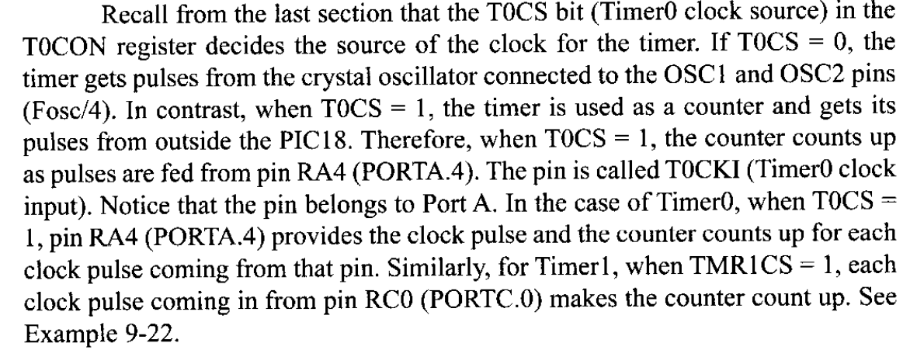
TOCS bit in TOCON register

Slide 34
Using external crystal for Timer1 clock

Slide 35
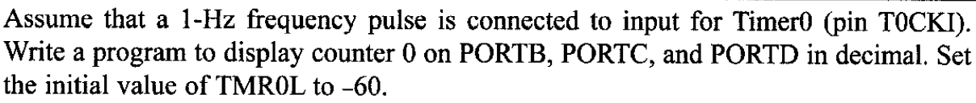
Example:
Solution

Slide 36
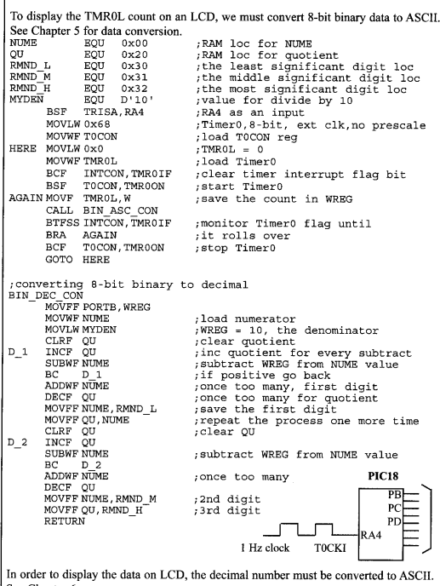

Slide 37
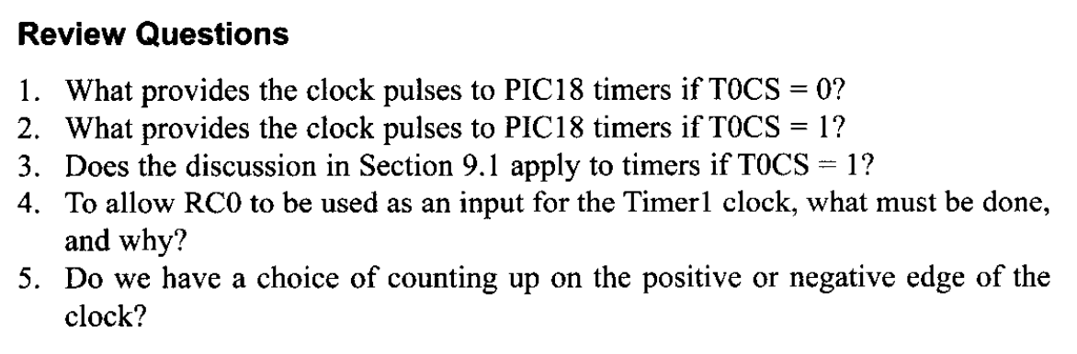

Slide 38
4.3. Serial communication
Basics of serial communication

Slide 39
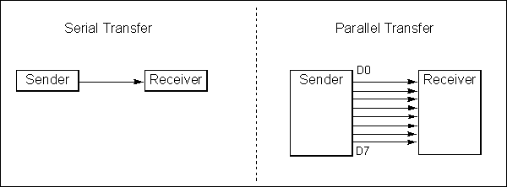
Serial versus Parallel Data Transfer

Slide 40
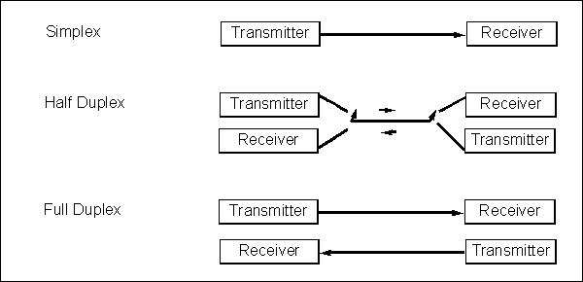
Simplex, Half-, and Full-Duplex Transfers
Half and full duplex transmission

Slide 41
Asynchronous serial communication and data frameming

Slide 42
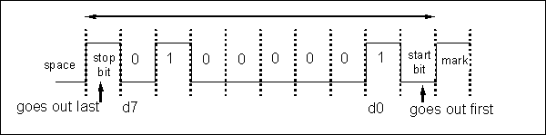
Framing ASCII ‘A’ (41H)
Start and stop bits

Slide 43
Data transfer rate
RS232 standards

Slide 44
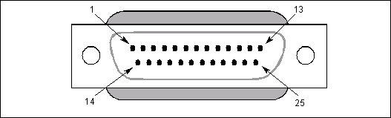
RS232 Pins
RS232 Connector DB-25

Slide 45
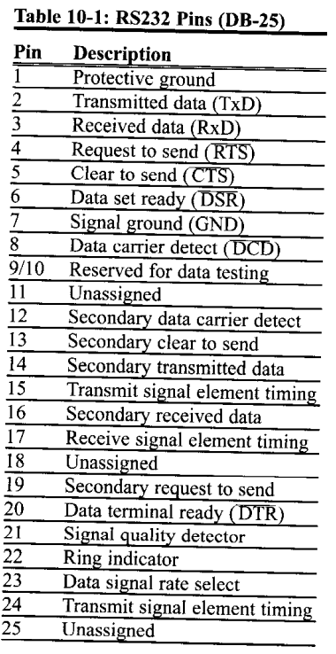
Data communication classification

Slide 46
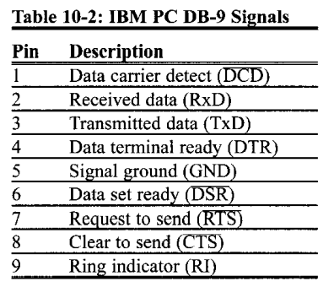
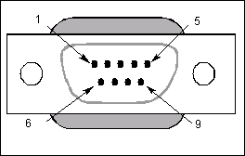
DB-9 9-Pin Connector
Examining RS232 hand shaking signals

Slide 47
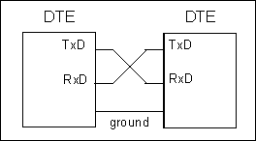
Null Modem Connection

Slide 48
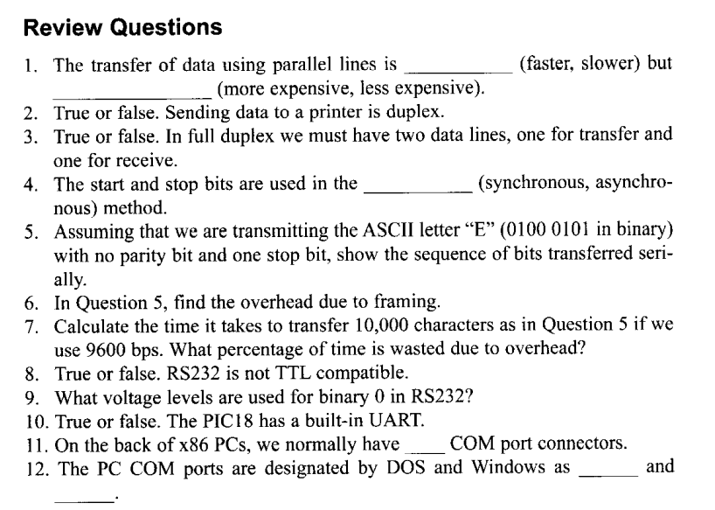

Slide 49
PIC 18 connection to RS232
  RX and TX pins in the PIC18

Slide 50
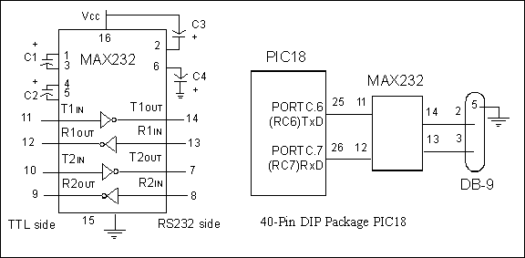
(a) Inside MAX232 and (b) its Connection to the PIC18 (Null Modem)
MAX232

Slide 51
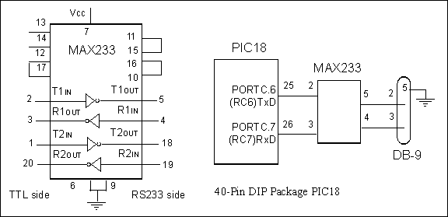
(a) Inside MAX233 and (b) Its Connection to the PIC18 (Null Modem)
MAX233

Slide 52
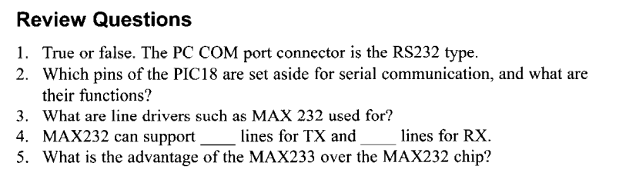

Slide 53
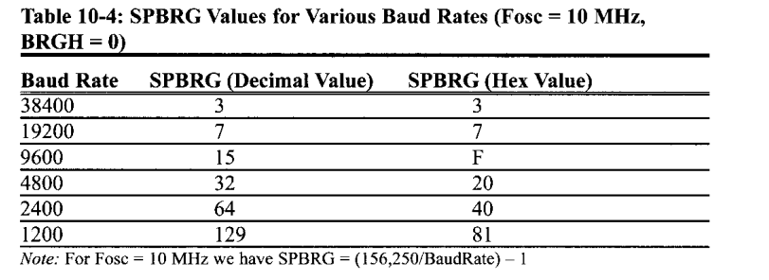
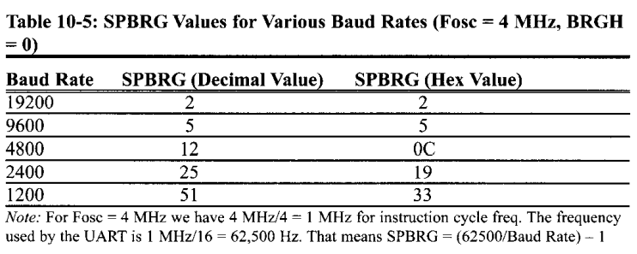
PIC18 serial port Programming in Assembly
SPBRG register and baud rate in the PIC18

Slide 55
TXREG register
RCREG register
TXSTA( transmit status and control register)

Slide 56
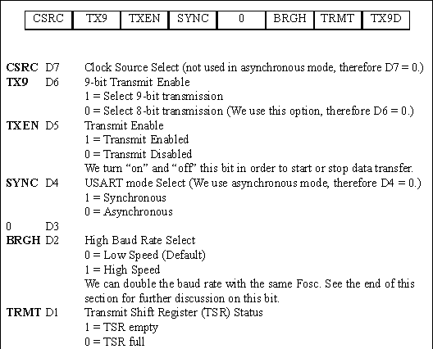
TXSTA: Transmit Status and Control Register

Slide 57
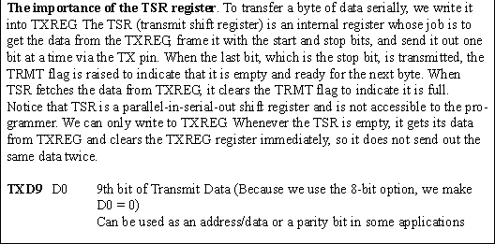
. TXSTA: Transmit Status and Control Register (cont.)

Slide 58
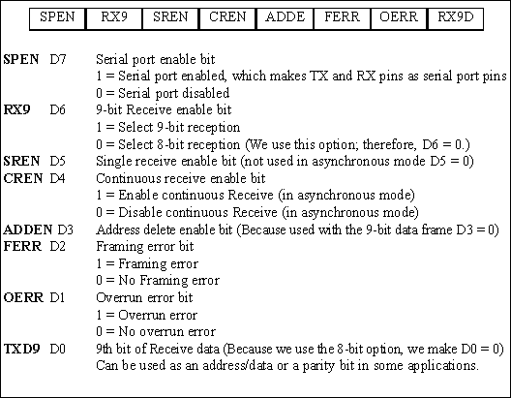
RCSTA: Receive Status and Control Register
RCSTA: Receive Status and Control Register

Slide 59
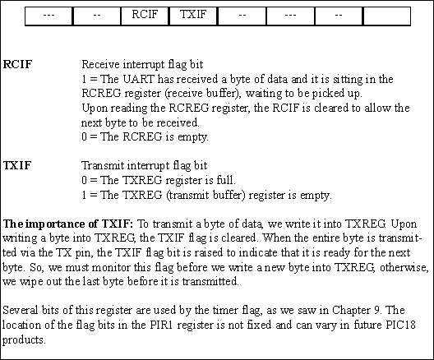
PIR1 (Peripheral Interrupt Register 1)

Slide 60
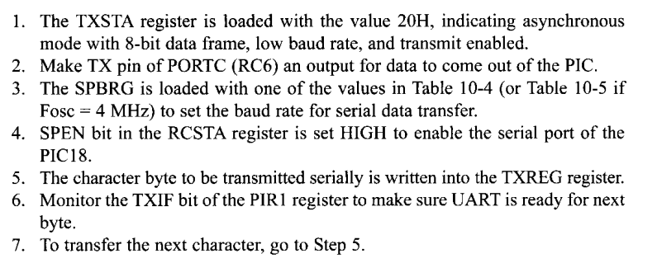
Programming the PIC18 to transfer data serially
In programming the PIC18 to transfer character byte serially, the following steps must be taken:

Slide 61
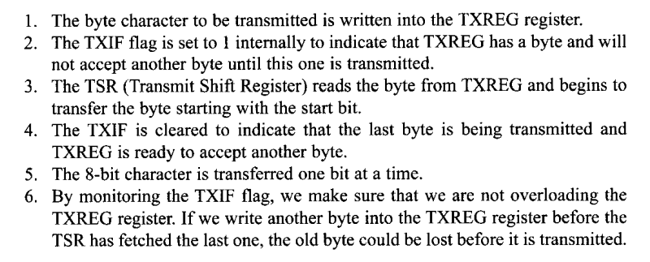
Importance of the TXIF flag
To understand the importance of the role TXIF,sequence of steps that the PIC18 goes through in transmitting a character via TX:

Slide 62
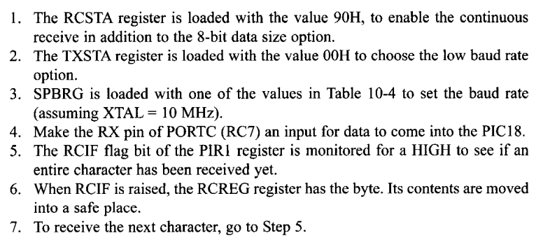
Programming the PIC18 to receive data serially

Slide 63
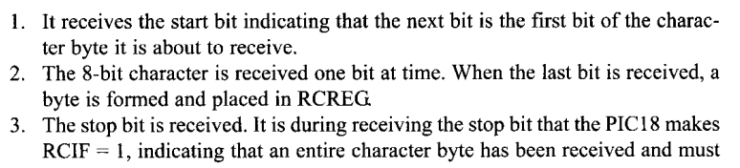

Importance of the RCIF flag bit
IN receiving bits via its RX pin, the PIC18 goes through the following steps:

Slide 64
Quadrupling the baud rate in the PIC18
Use a higher freq ctystal
Change a bit in the TXSTA register

Slide 65
Baud rate error calculation

Slide 66
Example for transmit and receive

Slide 67

Figure 10-12. Simplified USART Transmit Block Diagram

Slide 68
Interrupt based data transfer

Slide 69


Slide 70
PIC18 serial programming in C
  Transmitting and receiving data in PIC18 C
    Example 10-11

Slide 71
4.4.Interrupts
What is interrupt?
Purpose of the ISR( Interrupt service routine)
Main interrupt of the PIC18
What is interrupt vector table?
Enable and disable PIC18 interrupt
Program the PIC18 timers using interrupt

Slide 72
Self- study
  External HW interrupt of the PIC18
  Interrupt based serial communication
  Interrupt priority of the PIC18
  Program PIC interrupts in C

Slide 73

Redirecting the PIC18 from the Interrupt Vector Table at Power-Up

Slide 74

. Simplified View of Interrupts (default for power-on reset)

Slide 75

INTCON (Interrupt Control) Register

Slide 76
INTCON Register with Timer0 Interrupt Enable and Interrupt Flag

Slide 77

The Role of Timer Interrupt Enable Flag (TMRxIE)

Slide 78

For Program 11-3

Slide 79

PIC18 External Hardware Interrupt Pins

Slide 80

INT0–INT2 Hardware Interrupts

Slide 81

For Program 11-4

Slide 82

INTCON2 Register INTEDG Allows Positive or Negative Edge Trigger

Slide 83

For Program 11-5

Slide 84
PIE1 Register Bits Holding TXIE and RCIE

Slide 85

Serial Interrupt Enable Flags

Slide 86

INTCON (Interrupt Control) Register

Slide 87

PORTB-Change Interrupt Pins

Slide 88

PORTB-Change Interrupt (RBIF)

Slide 89

PORTB-Change Interrupt for Program 11-8

Slide 90

PORTB-Change Interrupt for Program 11-9

Slide 91

RCON Register. IPEN Allows Prioritizing the Interrupt into 2 Levels

Slide 92

IPR1 Peripheral Interrupt Priority Register 1

Slide 93

Interrupts with High-Priority (IP) Flag

Slide 94

High-Priority Interrupts (Redrawn from PIC18 Manual)

Slide 95

Low- and High-Priority Interrupt Selection (Redrawn from PIC18 Manual)

Slide 96

Low-Priority Interrupt Selection with IP Flag (Redrawn from PIC18 Manual)

Slide 97

Low-Priority Interrupt Selection with IP Flag (Redrawn from PIC18 Manual) (cont.)

